Slide 1
Classical Encryption
Techniques
Prepared By
T. Sree Sharmila

Slide 2
Classical encryption techniques
As opposed to modern cryptography
Goals:
  to introduce basic concepts & terminology of encryption
  to prepare us for studying modern cryptography

Slide 3
Basic terminology
Plaintext: original message to be encrypted
Ciphertext: the encrypted message
Enciphering or encryption: the process of converting plaintext into ciphertext
Encryption algorithm: performs encryption
  Two inputs: a plaintext and a secret key

Slide 4
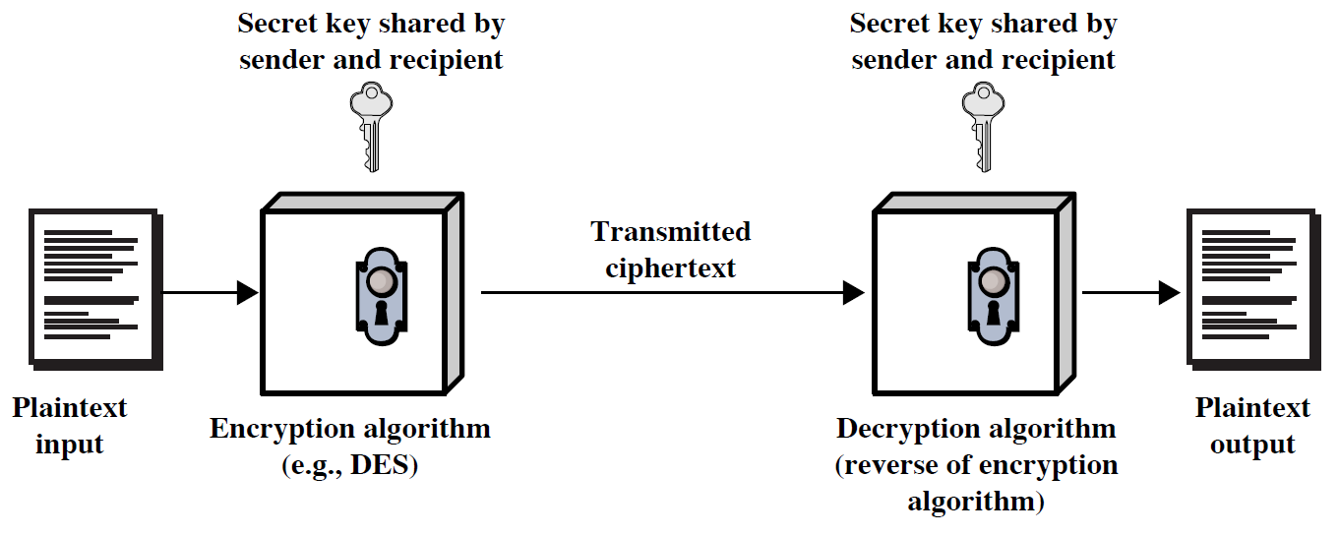
Symmetric Cipher Model

Slide 5
Deciphering or decryption: recovering plaintext from ciphertext
Decryption algorithm: performs decryption
  Two inputs: ciphertext and secret key
Secret key: same key used for encryption and decryption
  Also referred to as a symmetric key

Slide 6
Cipher or cryptographic system : a scheme for encryption and decryption
Cryptography: science of studying ciphers
Cryptanalysis: science of studying attacks against cryptographic systems
Cryptology: cryptography + cryptanalysis

Slide 7

Model for Network Security

Slide 8
Model for Network Security
using this model requires us to:
  design a suitable algorithm for the security transformation
  generate the secret information (keys) used by the algorithm
  develop methods to distribute and share the secret information
  specify a protocol enabling the principals to use the transformation and secret information for a security service
Notes:
Key: unique for each pair
protocol: encryption and decryption

Slide 9

Model for Network Access Security
Notes:
Stallings Fig 1-4.
The second model is concerned with controlled access to information or resources on a computer system, in the presence of possible opponents. Here appropriate controls are needed on the access and within the system, to provide suitable security. Some cryptographic techniques are useful here also.

Slide 10
Model for Network Access Security
using this model requires us to:
  select appropriate gatekeeper functions to identify users
  implement security controls to ensure only authorised users access designated information or resources
trusted computer systems can be used to implement this model

Slide 11
Summary
have considered:
  computer, network, internet security def’s
  security services, mechanisms, attacks
  X.800 standard
  models for network (access) security

Slide 12
Ciphers
Symmetric cipher: same key used for encryption and decryption
  Block cipher: encrypts a block of plaintext at a time (typically 64 or 128 bits)
  Stream cipher: encrypts data one bit or one byte at a time
Asymmetric cipher: different keys used for encryption and decryption

Slide 13
Symmetric Encryption
or conventional / secret-key / single-key
sender and recipient share a common key
all classical encryption algorithms are symmetric
The only type of ciphers prior to the invention of asymmetric-key ciphers in 1970’s
by far most widely used

Slide 14
Symmetric Encryption
Mathematically:
  Y = E_{K}(X) or Y = E(K, X)
  X = D_{K}(Y) or X = D(K, Y)
X = plaintext
Y = ciphertext
K = secret key
E = encryption algorithm
D = decryption algorithm
Both E and D are known to public

Slide 15
Cryptanalysis
Objective: to recover the plaintext of a ciphertext or, more typically, to recover the secret key.
Kerkhoff’s principle: the adversary knows all details about a cryptosystem except the secret key.
Two general approaches:
  brute-force attack
  non-brute-force attack (cryptanalytic attack)

Slide 16
Brute-Force Attack
Try every key to decipher the ciphertext.
On average, need to try half of all possible keys
Time needed proportional to size of key space
Key Size (bits) | Number of Alternative Keys | Time required at 1 decryption/µs | Time required at 10⁶ decryptions/µs
32 | 2³² = 4.3 × 10⁹ | 2³¹ µs = 35.8 minutes | 2.15 milliseconds
56 | 2⁵⁶ = 7.2 × 10¹⁶ | 2⁵⁵ µs = 1142 years | 10.01 hours
128 | 2¹²⁸ = 3.4 × 10³⁸ | 2¹²⁷ µs = 5.4 × 10²⁴ years | 5.4 × 10¹⁸ years
168 | 2¹⁶⁸ = 3.7 × 10⁵⁰ | 2¹⁶⁷ µs = 5.9 × 10³⁶ years | 5.9 × 10³⁰ years
26 characters (permutation) | 26! = 4 × 10²⁶ | 2 × 10²⁶ µs = 6.4 × 10¹² years | 6.4 × 10⁶ years

Slide 17
Cryptanalytic Attacks
May be classified by how much information needed by the attacker:
  Ciphertext-only attack
  Known-plaintext attack
  Chosen-plaintext attack
  Chosen-ciphertext attack

Slide 18
Ciphertext-only attack
Given: a ciphertext c
Q: what is the plaintext m?
An encryption scheme is completely insecure if it cannot resist ciphertext-only attacks.

Slide 19
Known-plaintext attack
Given: (m₁,c₁), (m₂,c₂), …, (m_{k},c_{k}) and a new ciphertext c.
Q: what is the plaintext of c?
Q: what is the secret key in use?

Slide 20
Chosen-plaintext attack
Given: (m₁,c₁), (m₂,c₂), …, (m_{k},c_{k}), where m₁, m₂, …, m_{k} are chosen by the adversary; and a new ciphertext c.
Q: what is the plaintext of c, or what is the secret key?

Slide 21
Example: chosen-plaintext attack
In 1942, US Navy cryptanalysts discovered that Japan was planning an attack on “AF”.
They believed that “AF” means Midway island.
Pentagon didn’t think so.
US forces in Midway sent a plain message that their freshwater supplies were low.
Shortly, US intercepted a Japanese ciphertext saying that “AF” was low on water.
This proved that “AF” is Midway.

Slide 22
Chosen-ciphertext attack
Given: (m₁,c₁), (m₂,c₂), …, (m_{k},c_{k}), where c₁, c₂, …, c_{k} are chosen by the adversary; and a new ciphertext c.
Q: what is the plaintext of c, or what is the secret key?

